Slide 1
UNIT 5
LESSON 2

Slide 2
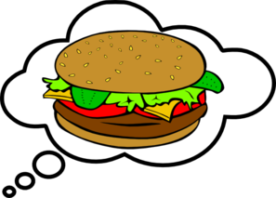
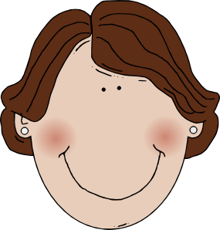
She hamburgers.
likes

Slide 3
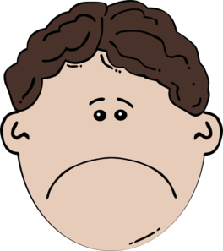
He lemonade.
doesn’t like

Slide 4
She hamburgers.
likes

Slide 5
like
They apples.

Slide 6
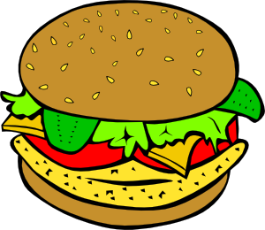
Does he hamburger and chips?
Yes, he does.
like

Slide 7
Does
he like chicken?
No, he doesn’t.

Slide 8
Does she like sausages?
No, she .
doesn’t

Slide 9
they like chips?
No, they don’t.
Do

Slide 10
Images courtesy of:
http://www.microsoft.com
http://www.clker.com
Presentation designed by the English Curriculum Development team, Cyprus Ministry of Education and Culture

