Slide 1
UNIT 2
YEAR 2 – Part B

Slide 2
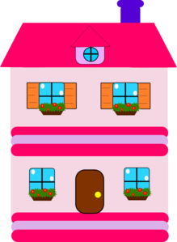
They are doll houses.

Slide 3
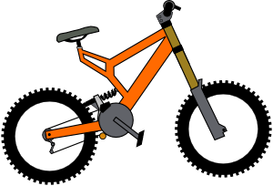
They are bicycles.

Slide 4
It’s a bicycle.

Slide 5
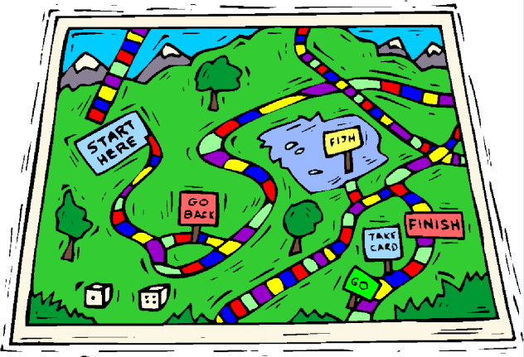
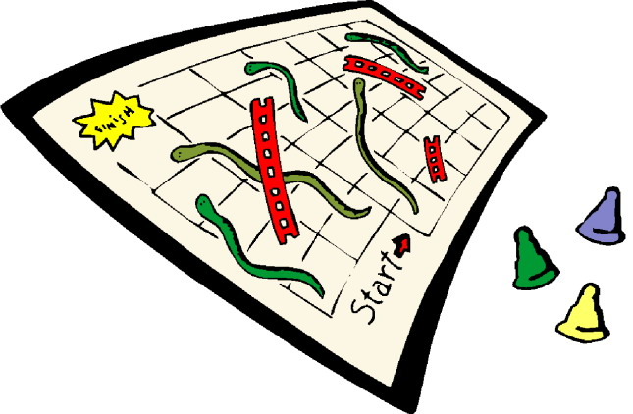
They are board games.

Slide 6
It’s a puzzle.

Slide 7
It’s a train.

Slide 8
They are trains.

Slide 9
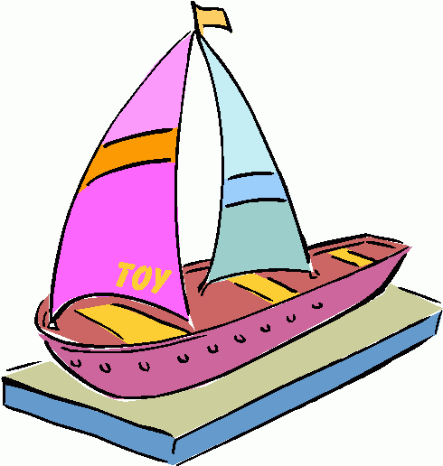
They are boats.

Slide 10
It’s a boat.

Slide 11
They are robots.

Slide 12
Presentation designed by the English Curriculum Development team, Cyprus Ministry of Education and Culture

