Slide 1
Unit 3 Year 2 – Part B
Lesson 1 - Practice

Slide 2
Let’s read the word! What is it?
day

Slide 3
Let’s read the word! What is it?
MONDAY
TUESDAY
WEDNESDAY
THURSDAY
FRIDAY
SATURDAY
SUNDAY
day

Slide 4
Let’s read the word! What is it?
say

Slide 5
Let’s read the word! What is it?
say

Slide 6
Let’s read the word! What is it?
bay

Slide 7
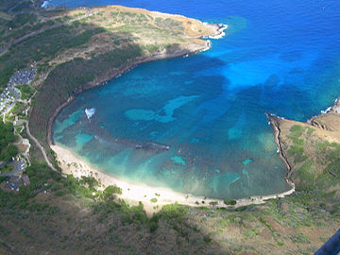
Let’s read the word! What is it?
bay

Slide 8
Let’s read the word! What is it?
hay

Slide 9
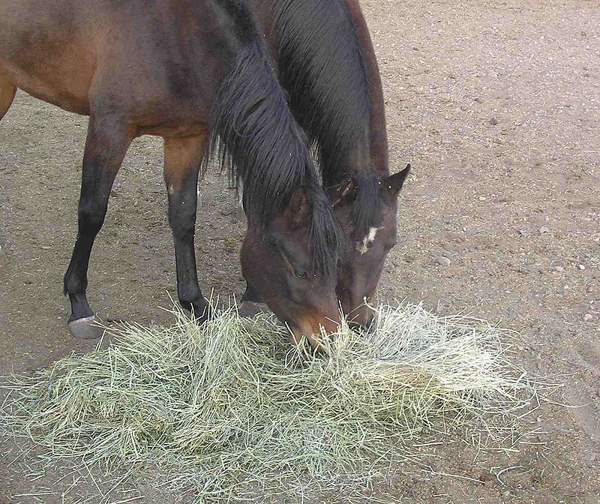
Let’s read the word! What is it?
hay

Slide 10
Let’s read the word! What is it?
toad

Slide 11
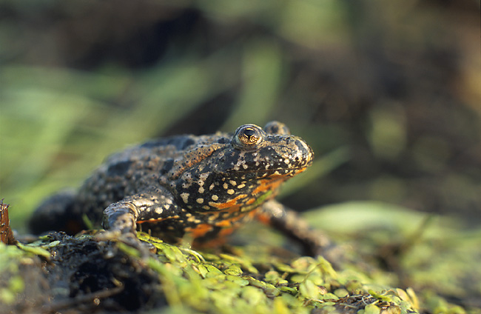
Let’s read the word! What is it?
toad

Slide 12
Let’s read the word! What is it?
road

Slide 13
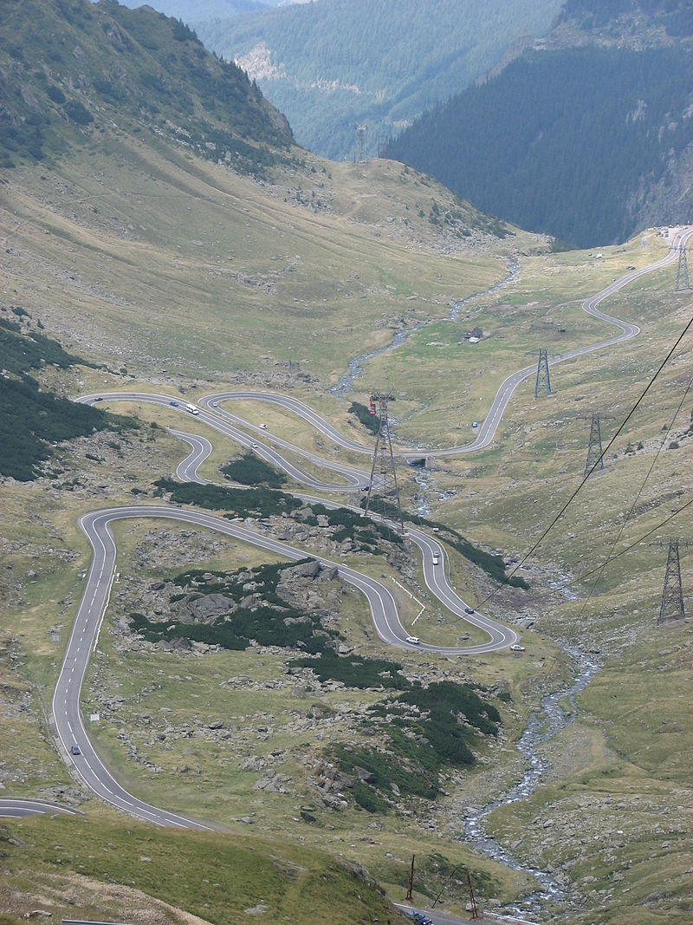
Let’s read the word! What is it?
road

Slide 14
Let’s read the word! What is it?
boat

Slide 15
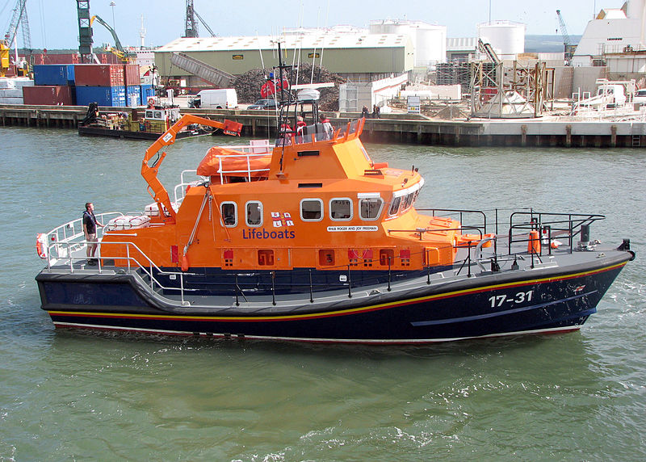
Let’s read the word! What is it?
boat

Slide 16
Presentation designed by the English Curriculum Development team, Cyprus Ministry of Education and Culture

