Slide 1
Unit 4 Year 2 – Part B
Lesson 1

Slide 2
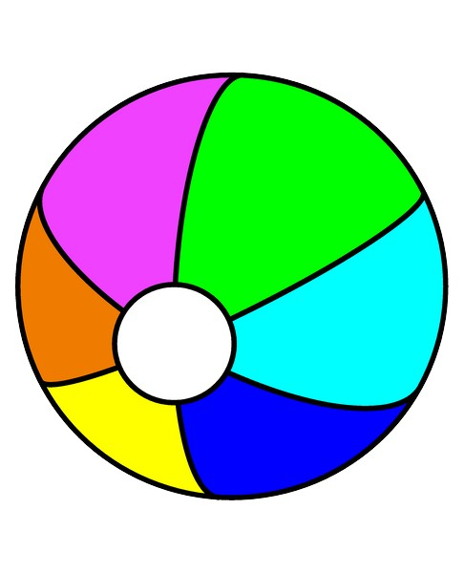
What is it?
It’s a ball.
It’s a cat.
It’s a dog.

Slide 3
What is it?
It’s a ball.
It’s a cat.
It’s a dog.

Slide 4
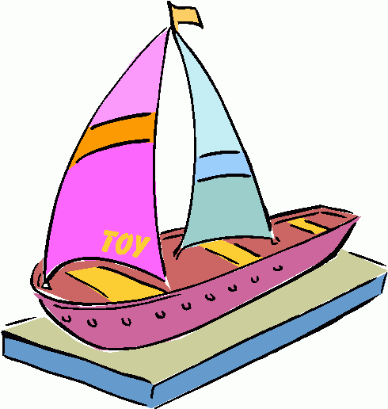
What is it?
It’s a coat.
It’s a boat.
It’s a tomato.

Slide 5
What is it?
It’s a coat.
It’s a boat.
It’s a tomato.

Slide 6
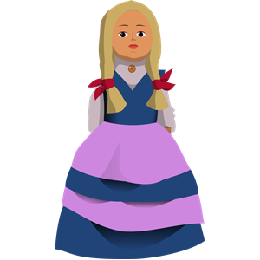
What is it?
It’s a dog.
It’s a doll.
It’s a banana.

Slide 7
What is it?
It’s a dog.
It’s a doll.
It’s a banana.

Slide 8
What are they?
It’s a banana.
They are bananas.

Slide 9
What are they?
It’s a banana.
They are bananas.

Slide 10
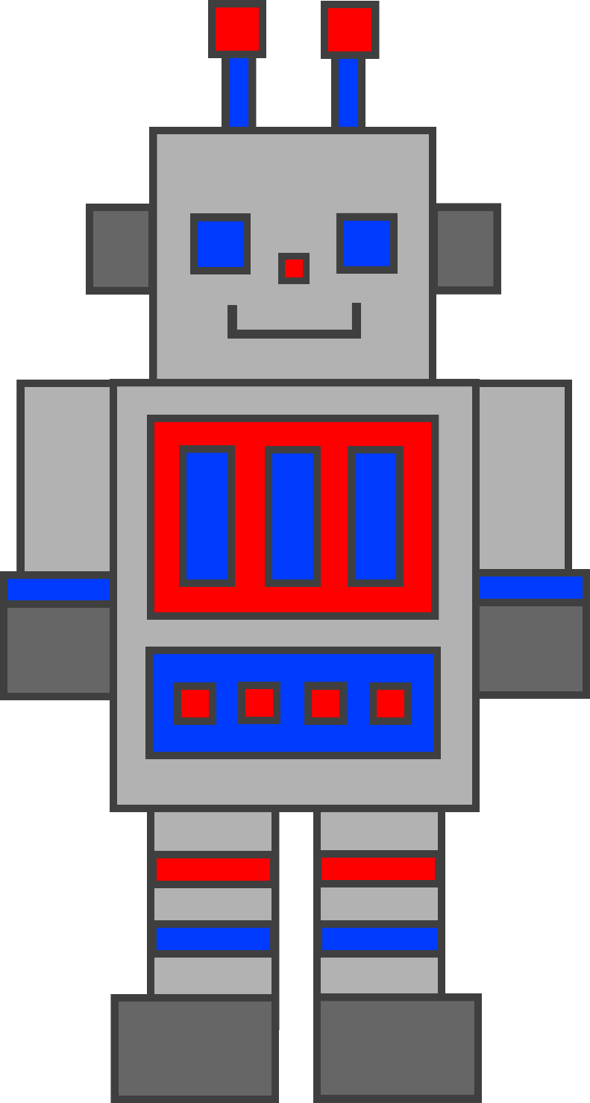
What is it?
It’s a robot.
They are robots.

Slide 11
What is it?
It’s a robot.
They are robots.

Slide 12
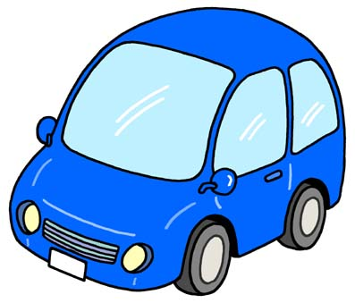
What are they?
It’s a car.
They are cars.

Slide 13
What are they?
It’s a car.
They are cars.

Slide 14
Presentation designed by the English Curriculum Development team, Cyprus Ministry of Education and Culture

