Slide 1
Unit 4
Year 2 - Part B

Slide 2


What are they?

Slide 3

They are pens.

Slide 4
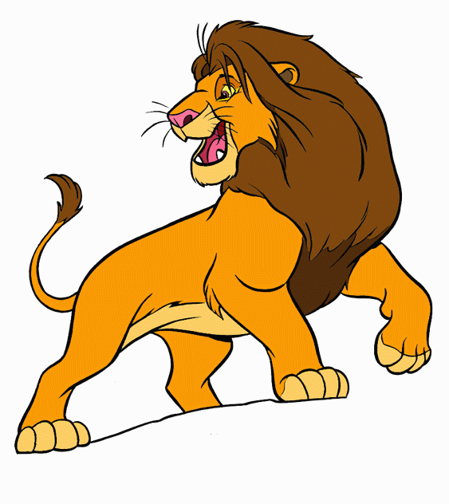
What is it?

Slide 5
It’s a lion.

Slide 6
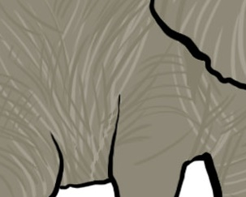
What are they?

Slide 7
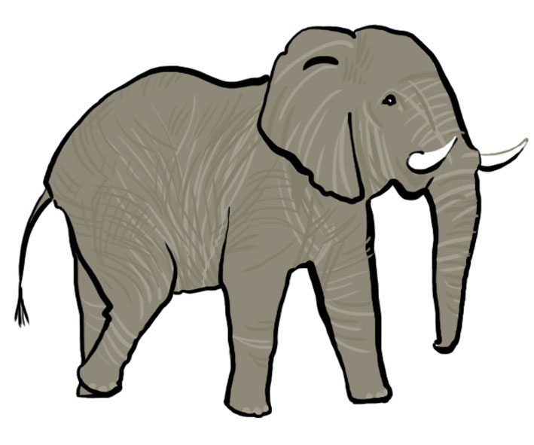
They are elephants.

Slide 8

What is it?

Slide 9

It’s a pencil case.

Slide 10

What is it?

Slide 11

It’s a ball.

Slide 12

What are they?

Slide 13

They are apples.

Slide 14
What is it?

Slide 15
It’s a car.

Slide 16
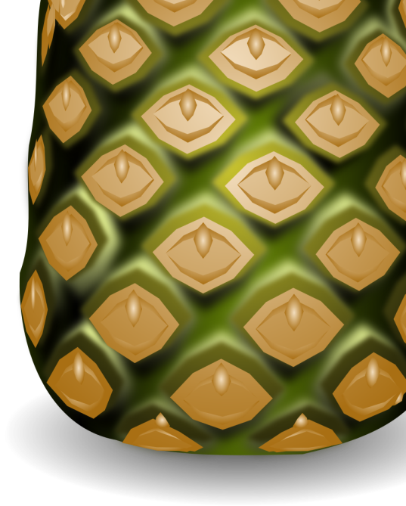
What is it?

Slide 17

It’s a pineapple.

Slide 18
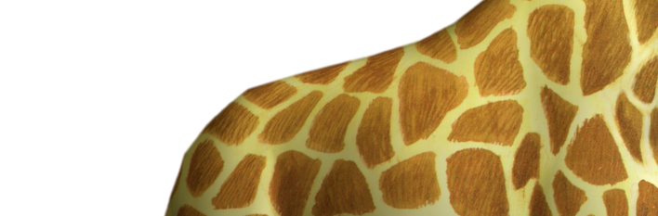
What are they?

Slide 19
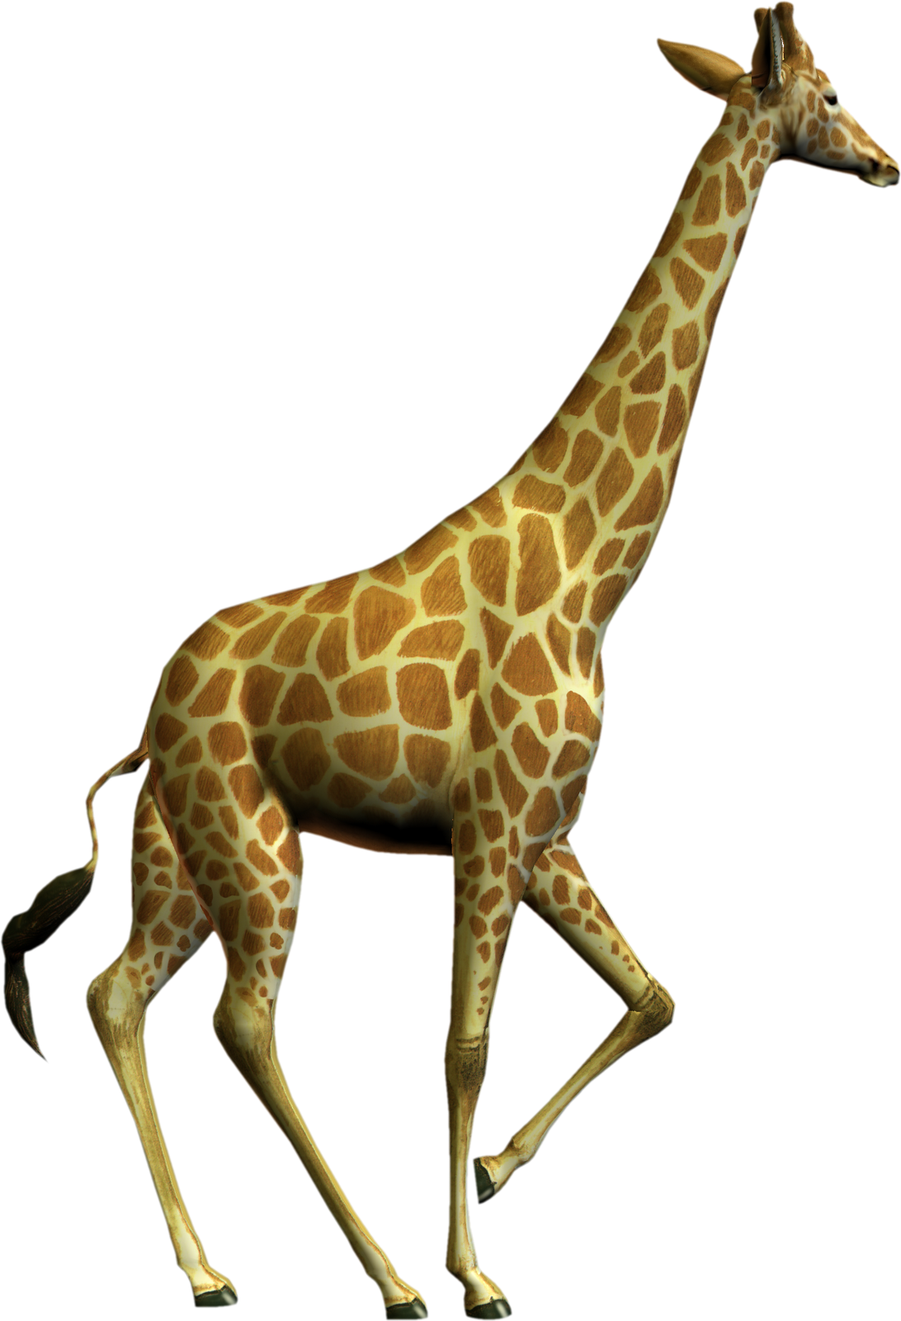
They are giraffes.

Slide 20
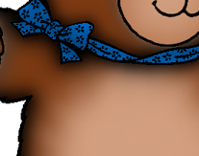
What is it?

Slide 21

It’s a teddy bear.

Slide 22
Images courtesy of Microsoft clipart
Presentation designed by the English Curriculum Development team, Cyprus Ministry of Education and Culture

