Slide 1
Unit 5
Lesson 1

Slide 2
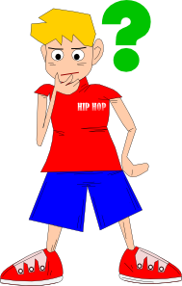
Does he like football?

Slide 3
No, he doesn’t.
He doesn’t like football.

Slide 4
Does she like basketball?

Slide 5
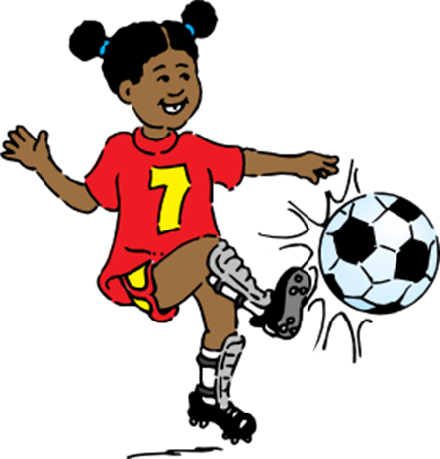
No, she doesn’t.
She likes football.

Slide 6
Does she like tennis?

Slide 7
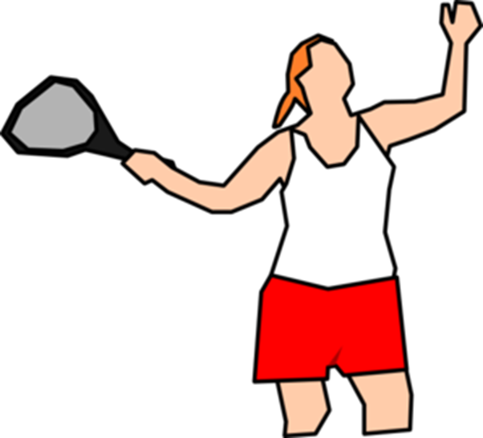
Yes, she does.
She likes tennis

Slide 8
Do they like volleyball?

Slide 9
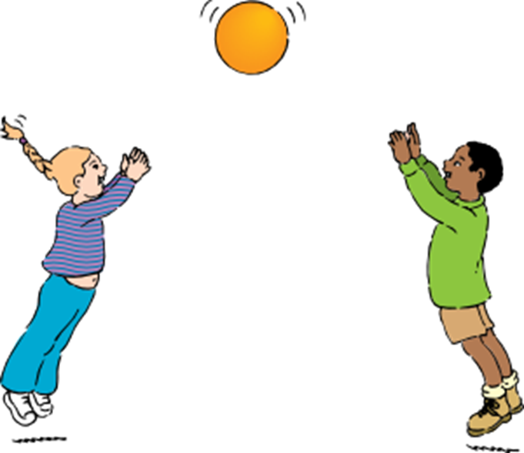
Yes, they do.
They like volleyball.

Slide 10
Does he like tennis?

Slide 11
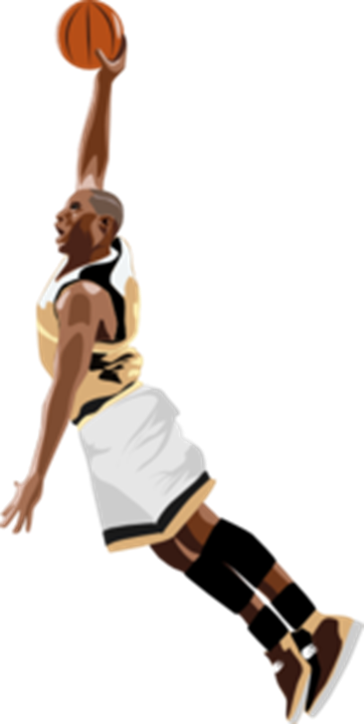
No, he doesn’t.
He likes basketball.

Slide 12
Does he like tennis?

Slide 13
Yes, he does.
He likes tennis.

Slide 14
Images courtesy of:
http://www.microsoft.com
http://www.clker.com
Presentation designed by the English Curriculum Development team, Cyprus Ministry of Education and Culture

