Slide 1
Unit 3

Slide 2
I ___________ school!

Slide 3
I like school!

Slide 4
I ___________ books!

Slide 5
I like books!

Slide 6
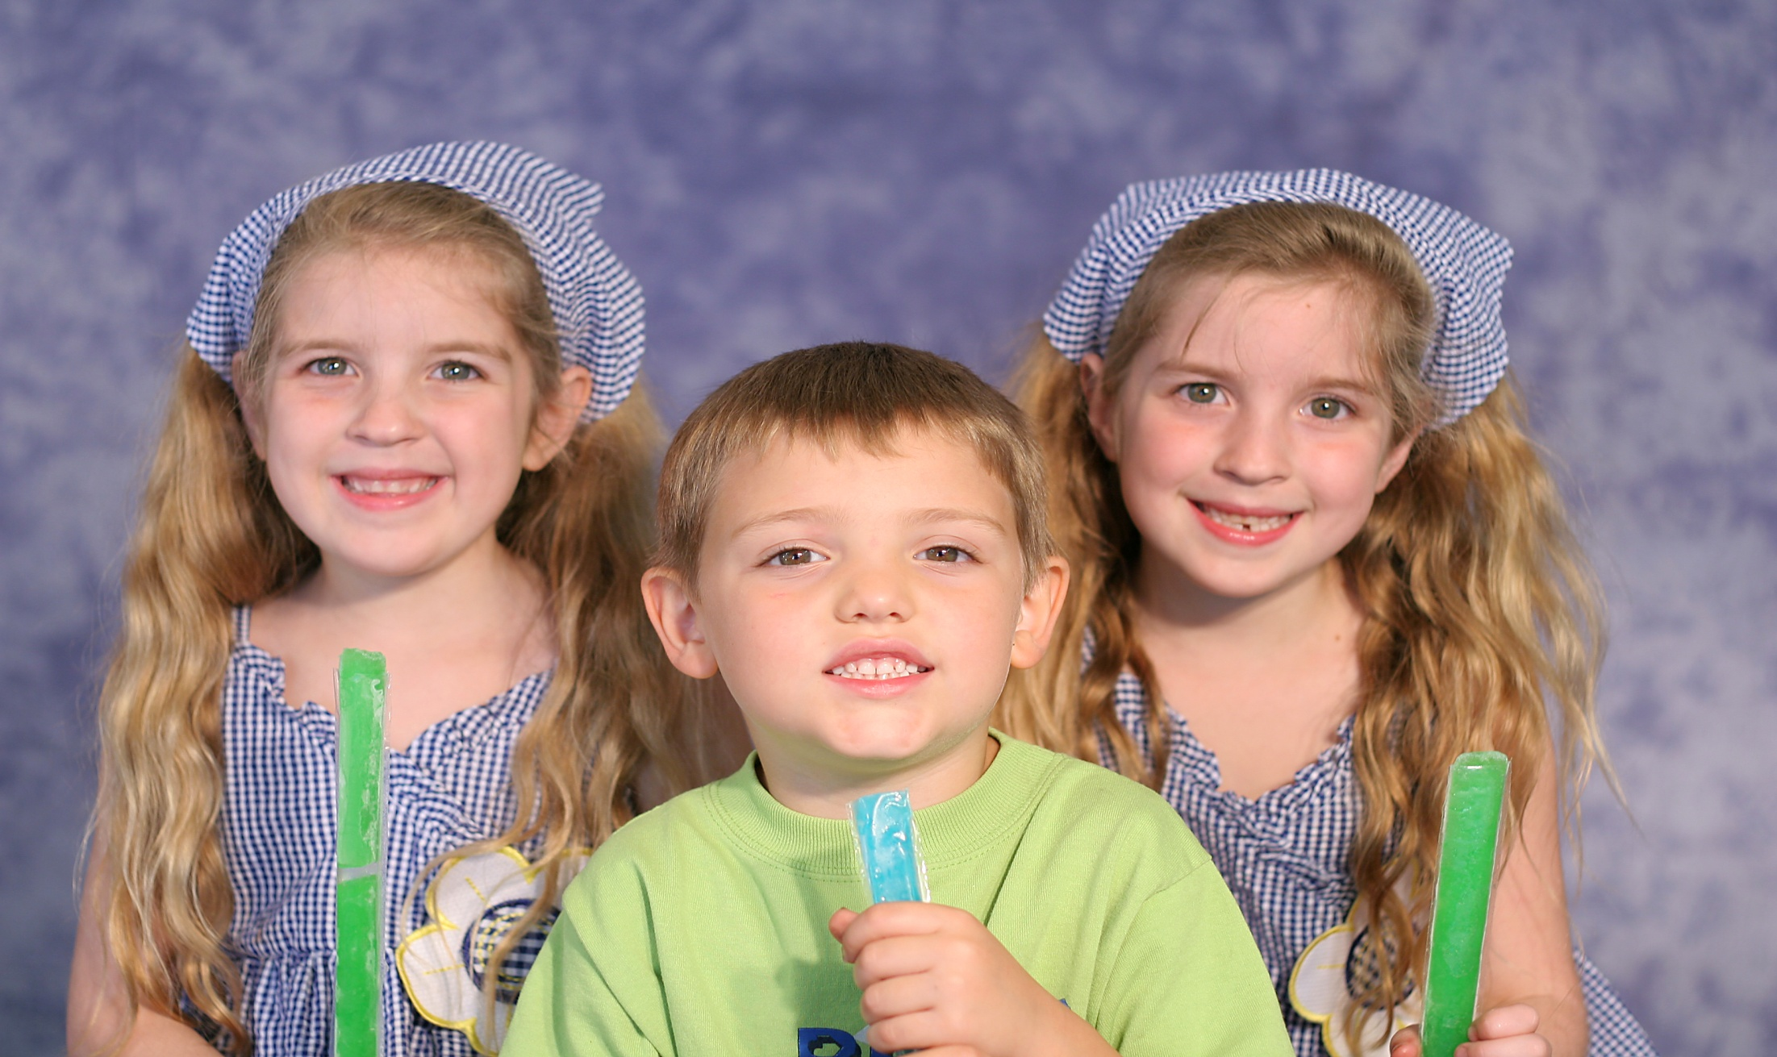
We ___________ ice lollies!

Slide 7
We love ice lollies!

Slide 8
I _______ pizza!

Slide 9
I don’t like pizza!

Slide 10
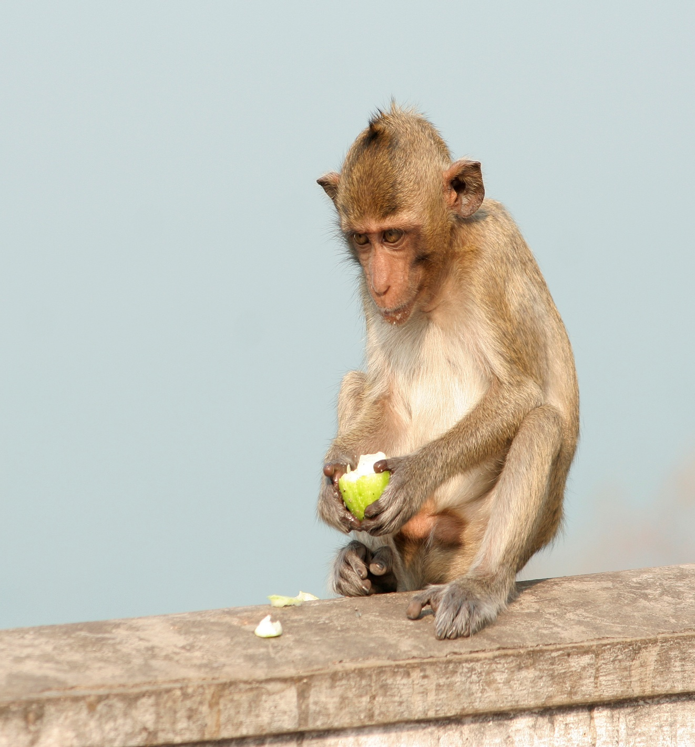
I ______
guava!

Slide 11
I hate
guava!

Slide 12
I _______ songs!

Slide 13
I love songs!

Slide 14
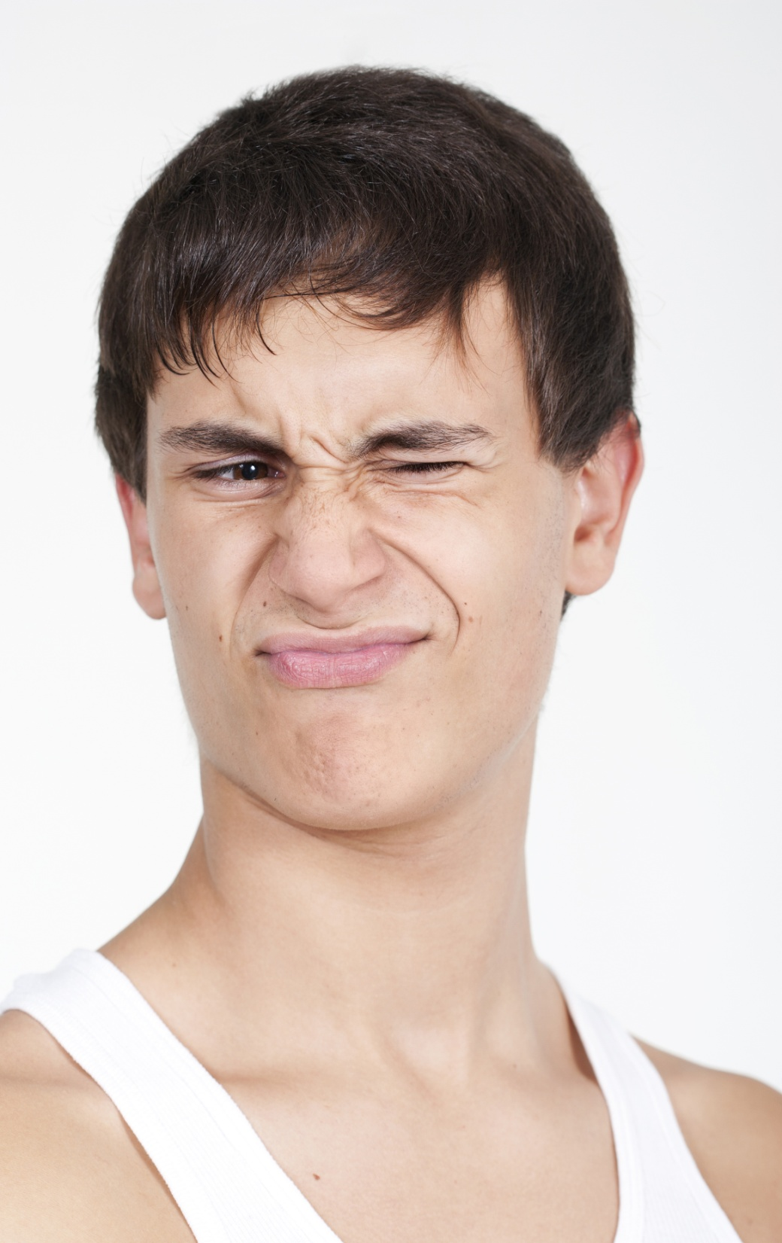
I ______
coffee!

Slide 15
I hate
coffee!

Slide 16
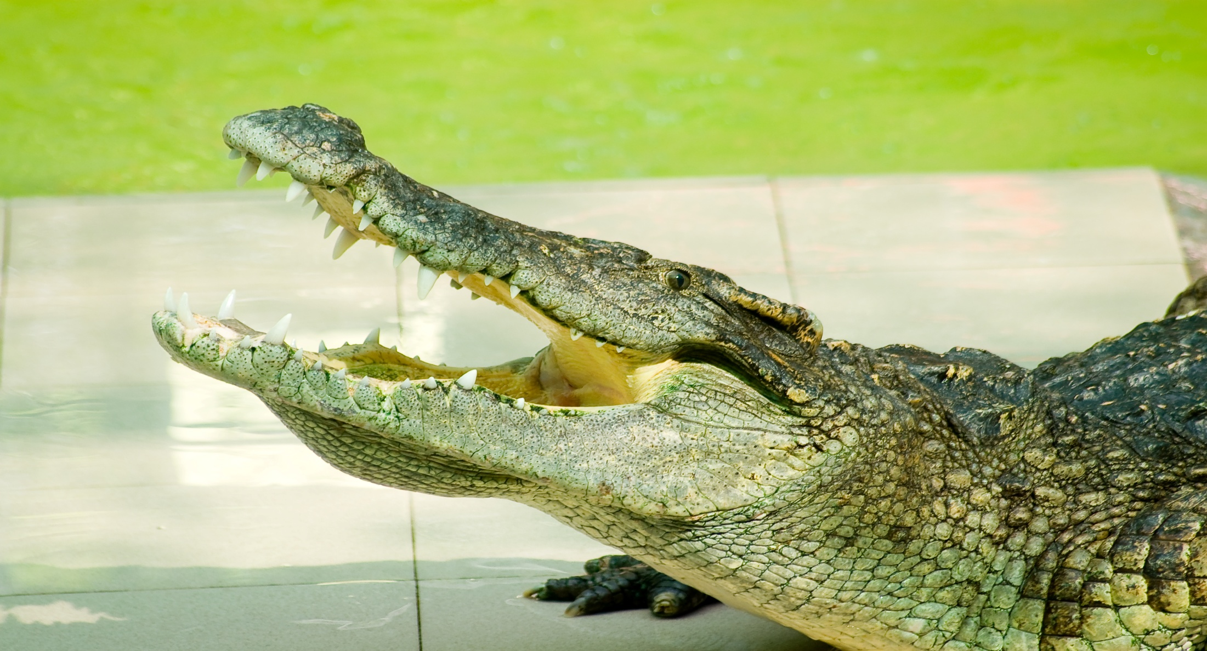
I _____fish!

Slide 17
I love fish!

Slide 18
Images from:
http://www.stockfreeimages.com
http://www.shutterstock.com
Presentation designed by the English Curriculum Development team, Cyprus Ministry of Education and Culture

