Slide 1
Unit 4
Year 6
Lesson 4 – Evaluation

Slide 2
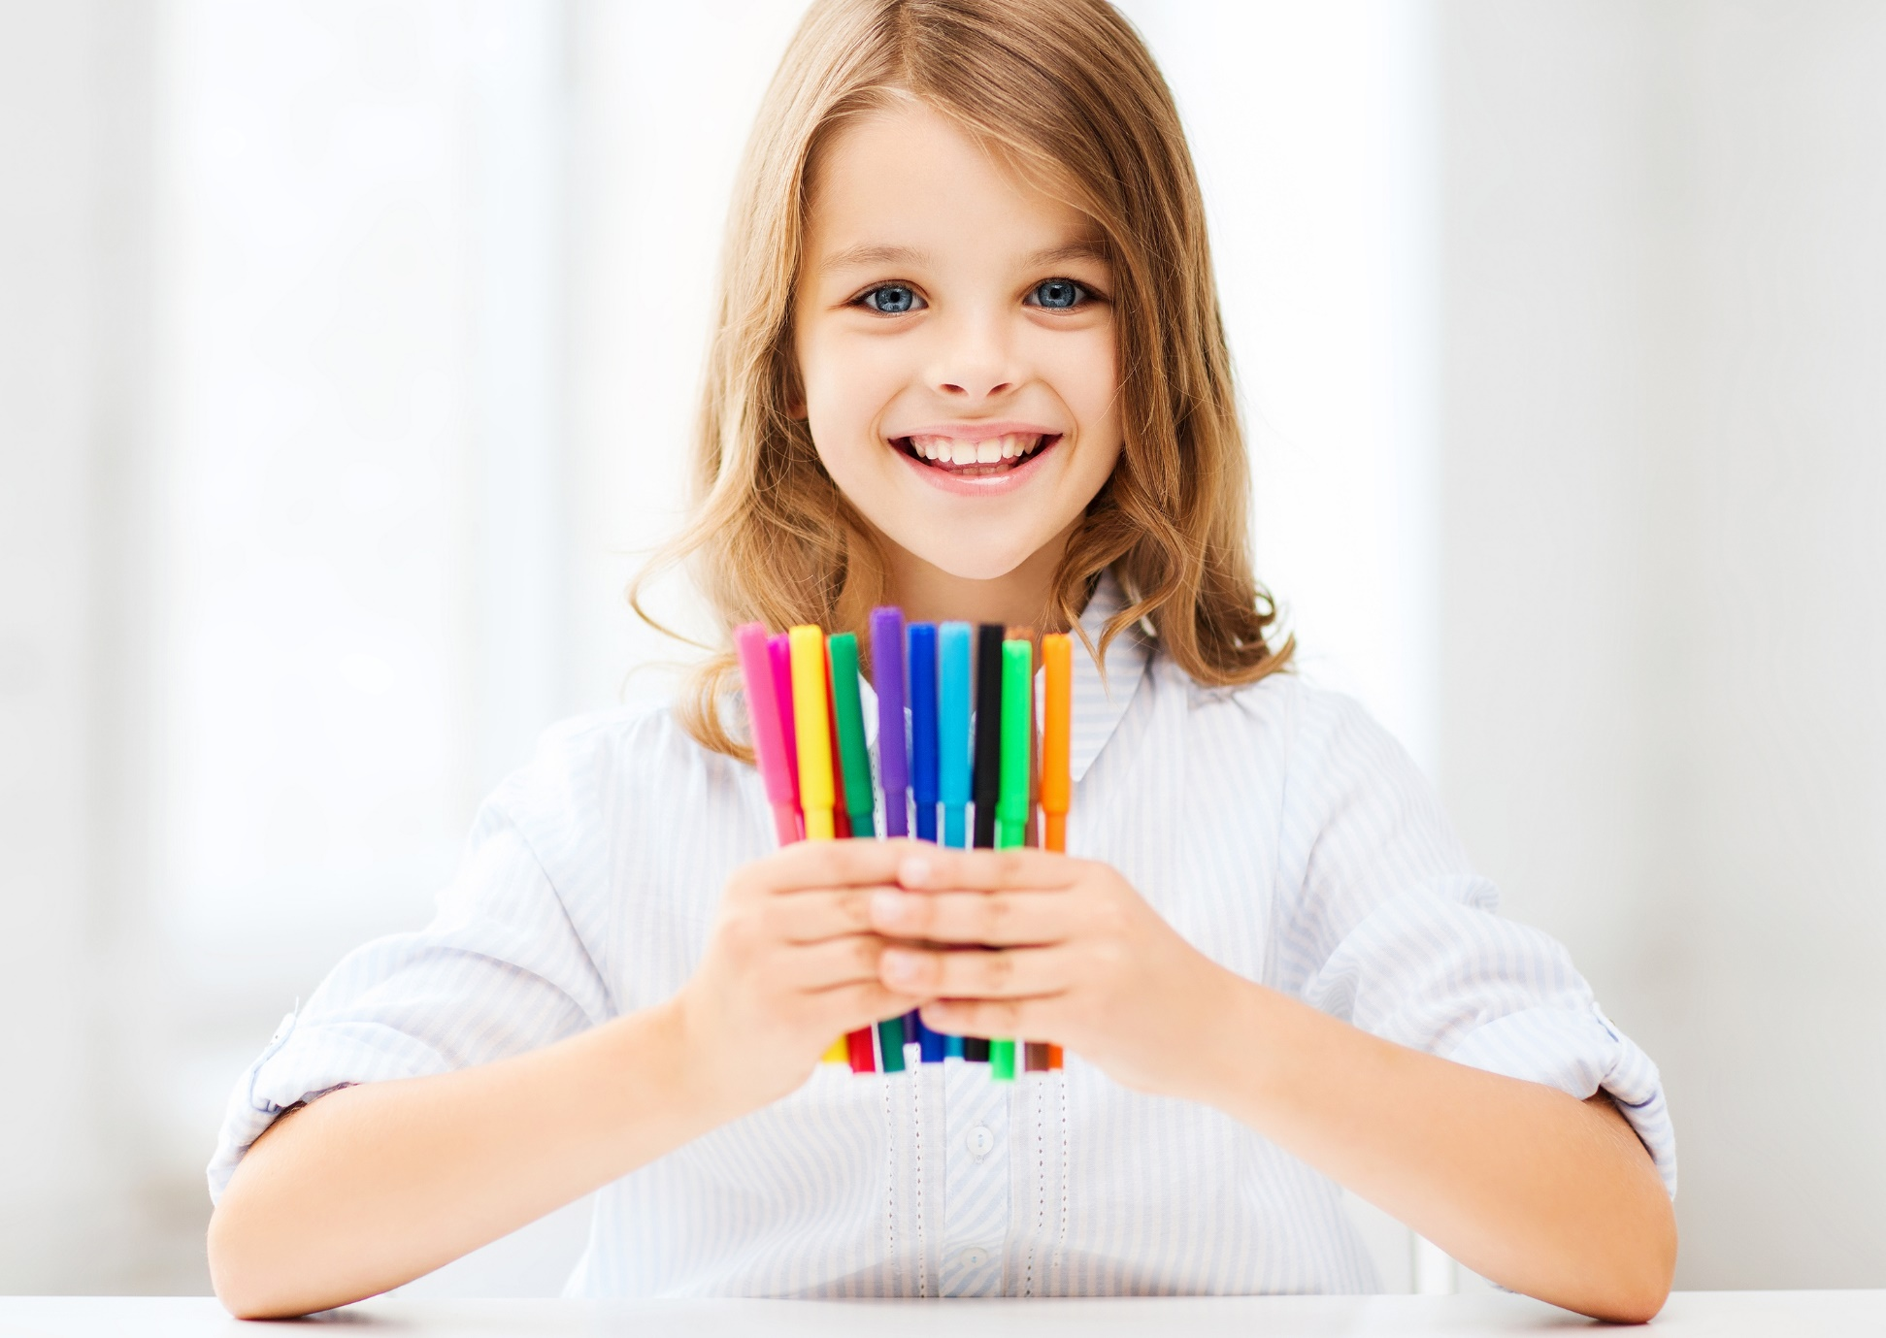
I like drawing. I usually draw pictures in the afternoon.
It is happening now.
It happens regularly.
It’s going to happen later.
It happened in the past.

Slide 3
I like boots! I’m going to buy new boots, tomorrow!
It is happening now.
It happens regularly.
It’s going to happen later.
It happened in the past.

Slide 4
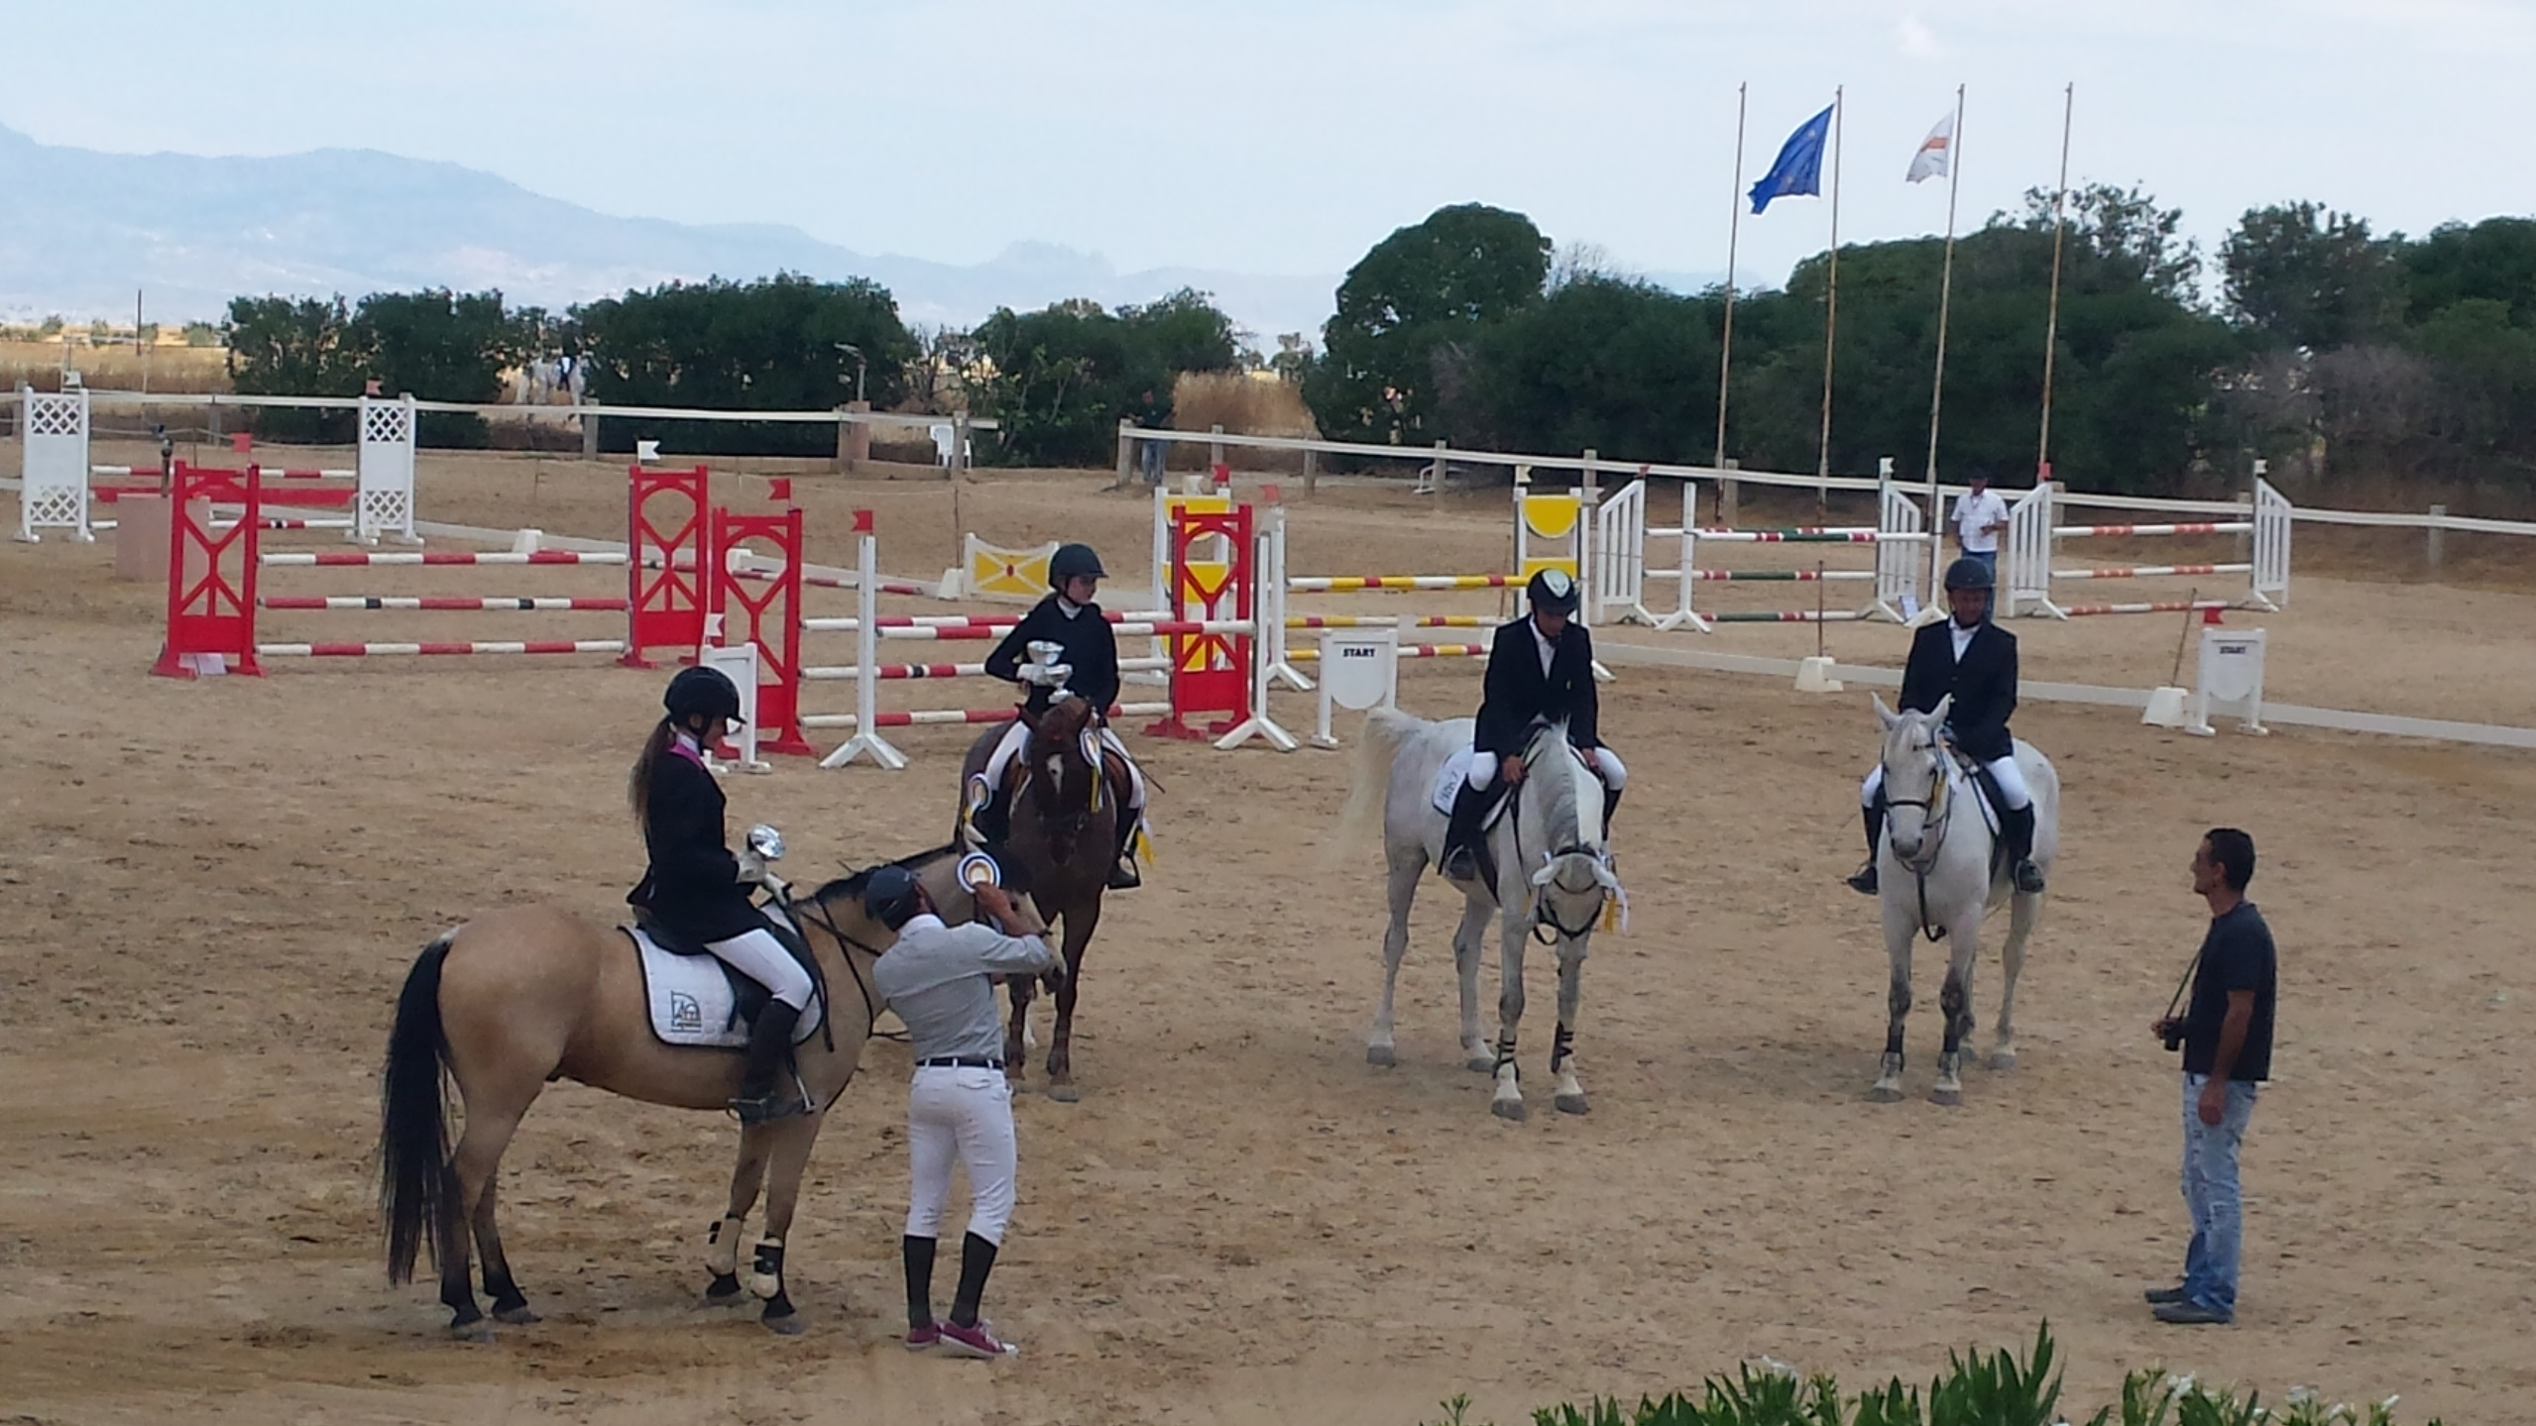
There are riding competitions once a month.
It is happening now.
It happens regularly.
It’s going to happen later.
It happened in the past.

Slide 5
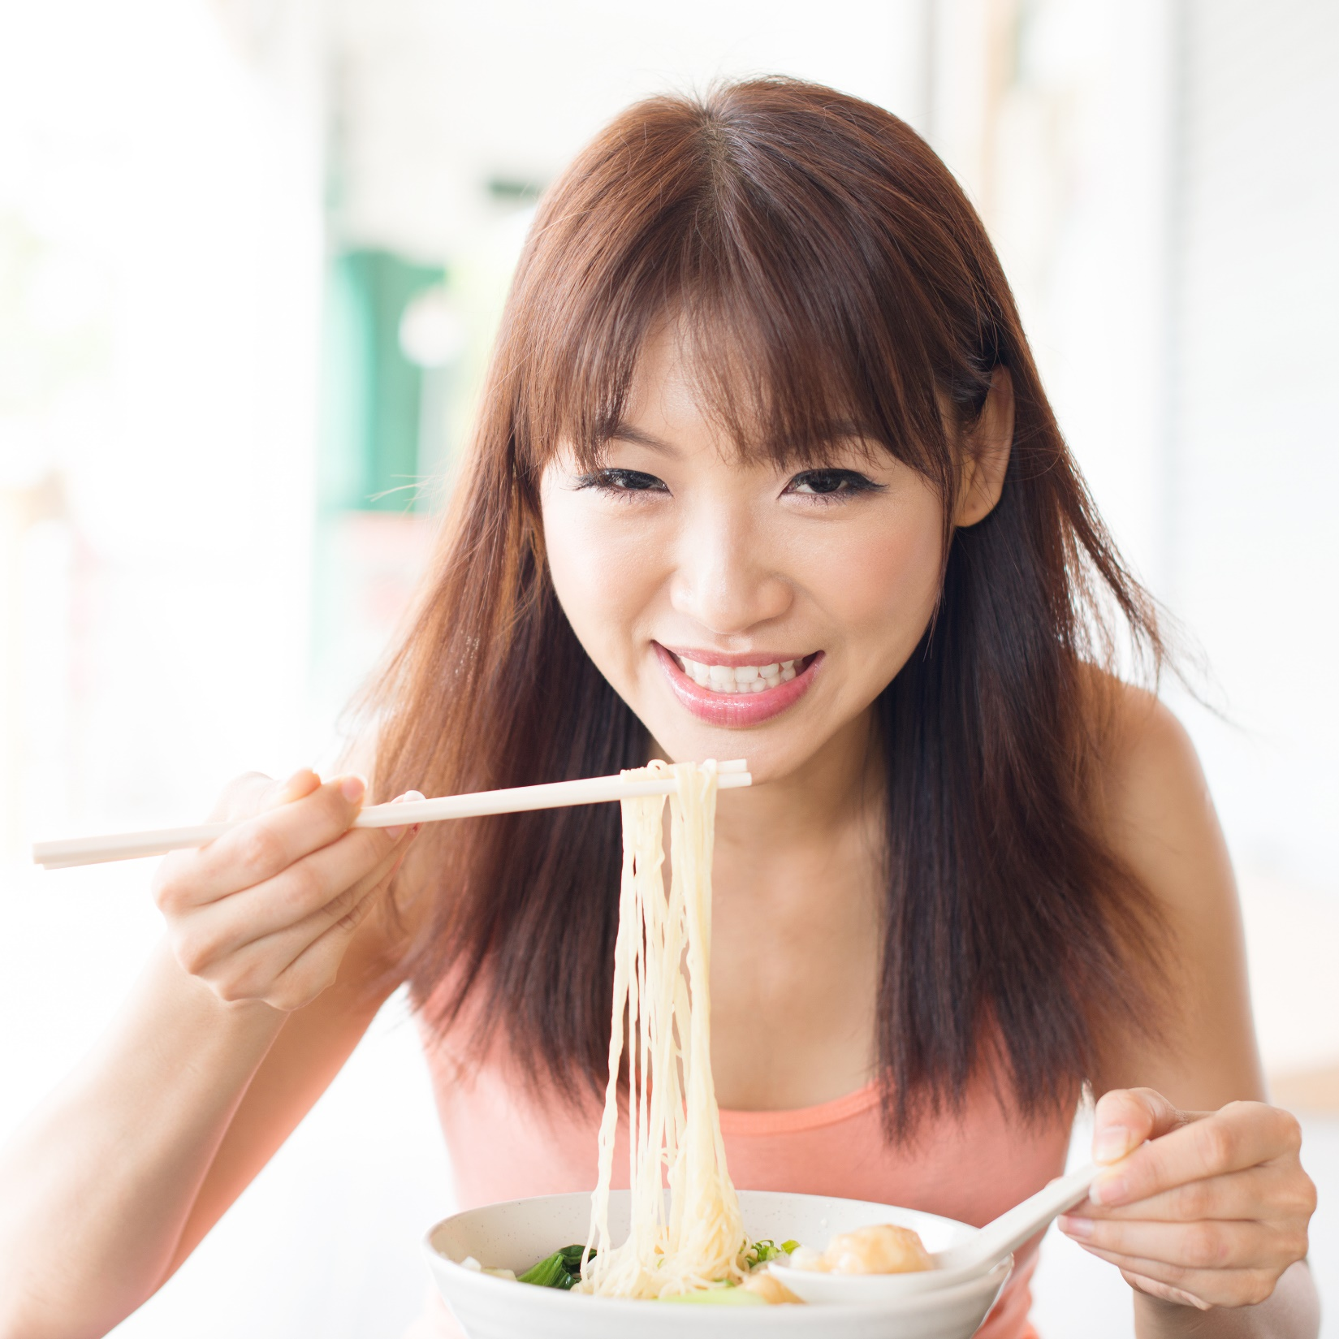
Li likes noodles.
She _________ noodles twice a week.
is eating
eats
is going to eat

Slide 6
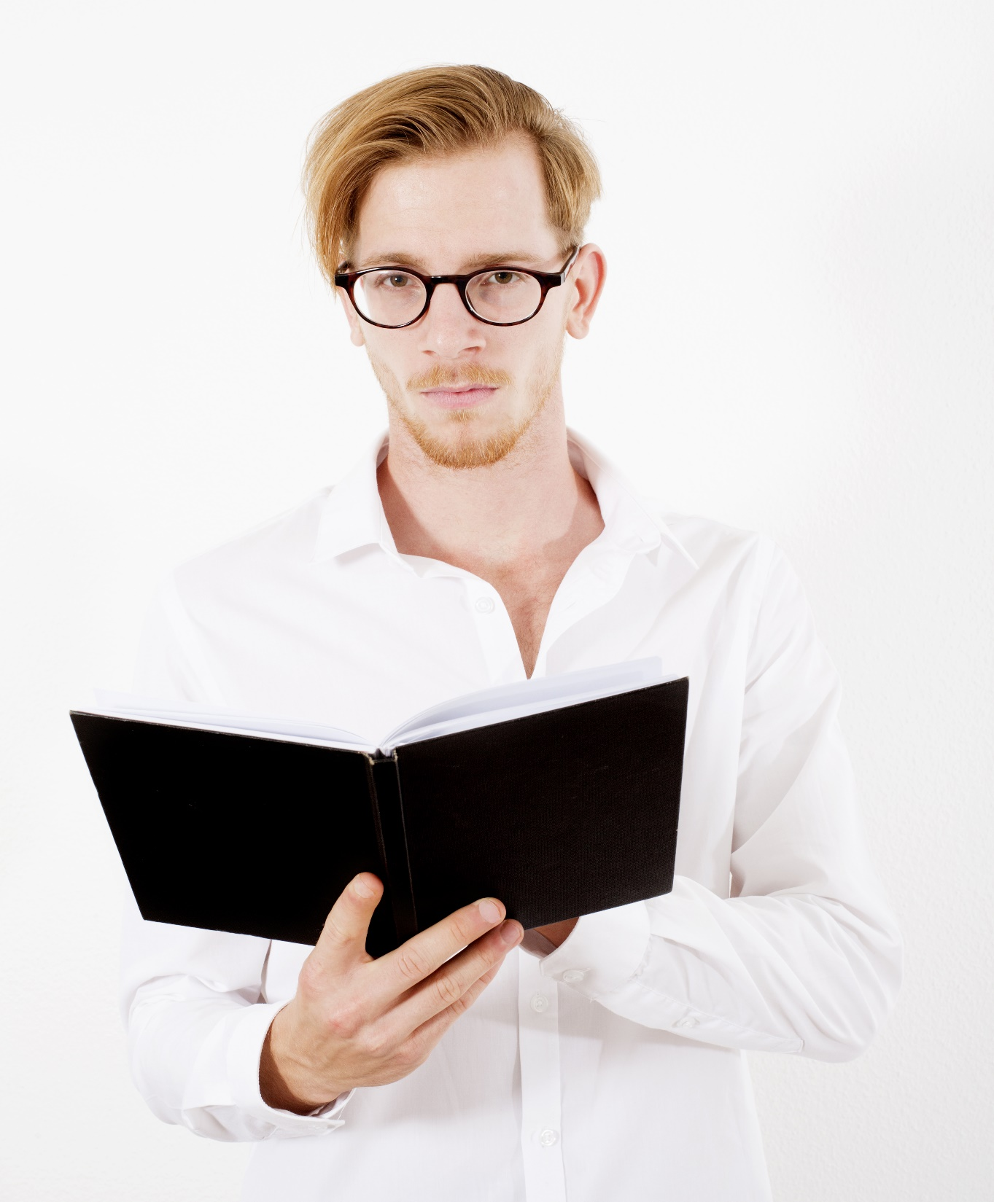
Tom likes science fiction books.
He _________ a famous science fiction book now.
is reading
reads
is going to read

Slide 7
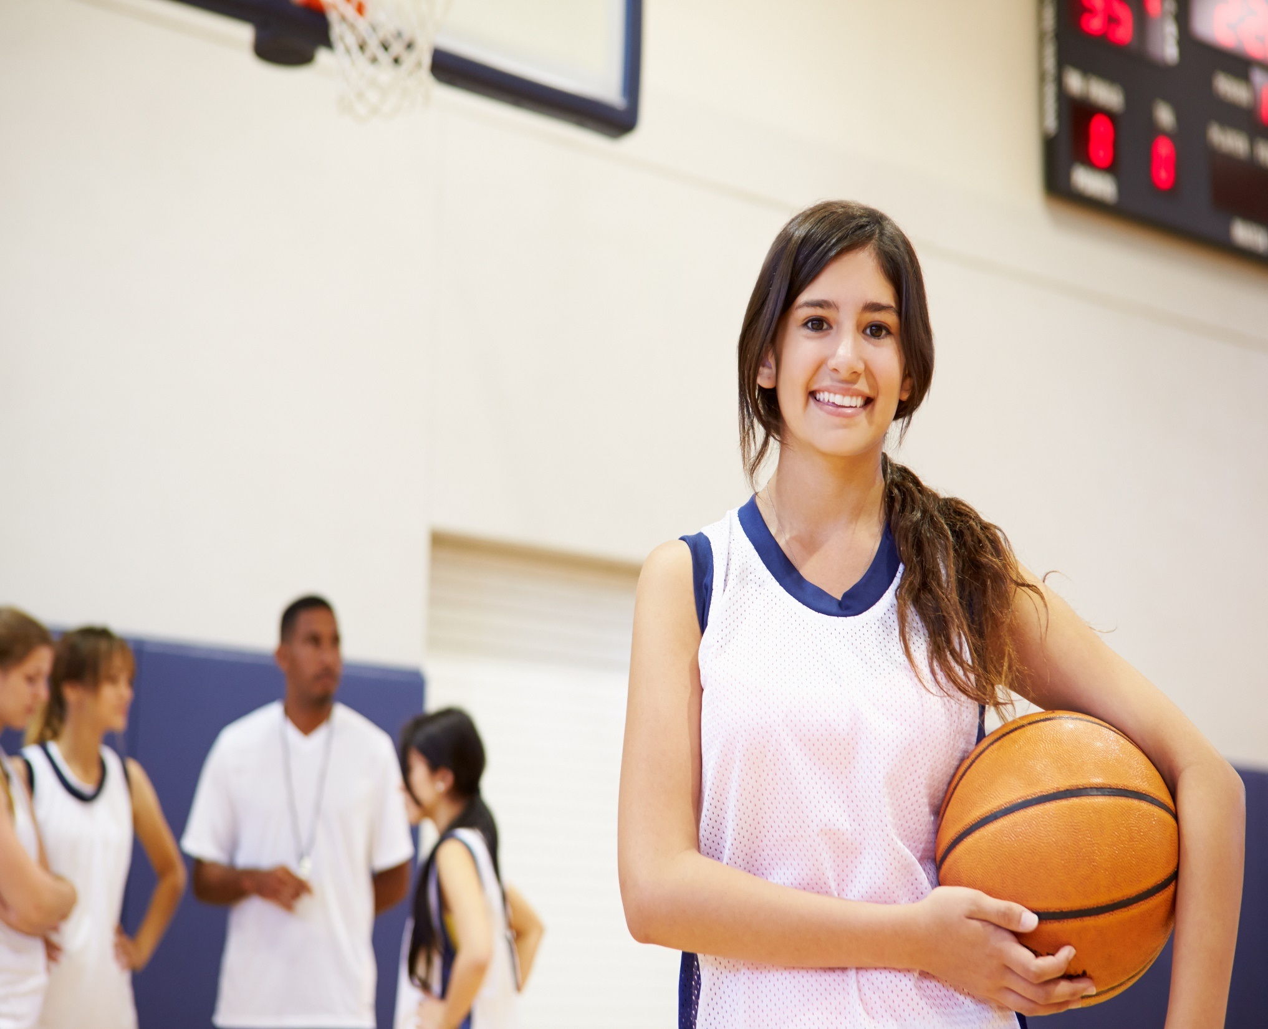
Salma is in the basketball team.
She __________ basketball tomorrow.
played
plays
is going to play

Slide 8
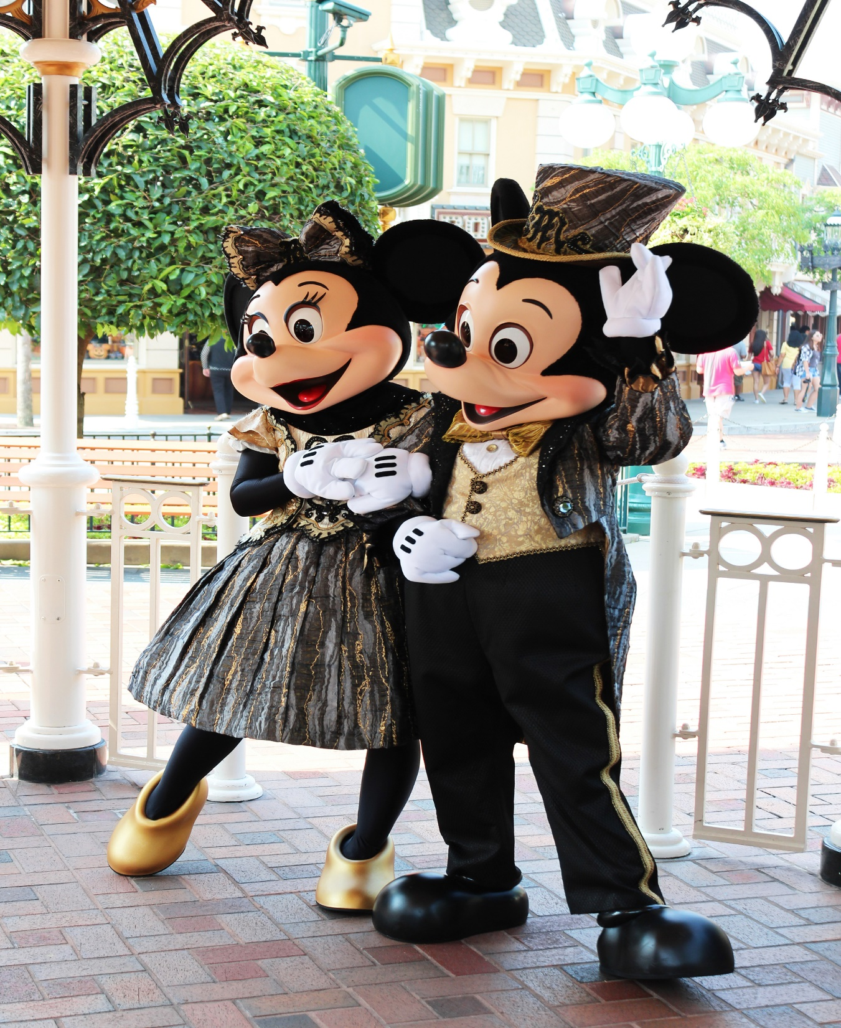
Mickey and Minnie live in Disneyland.
They ______fun every day.
are having
have
are going to have

Slide 9
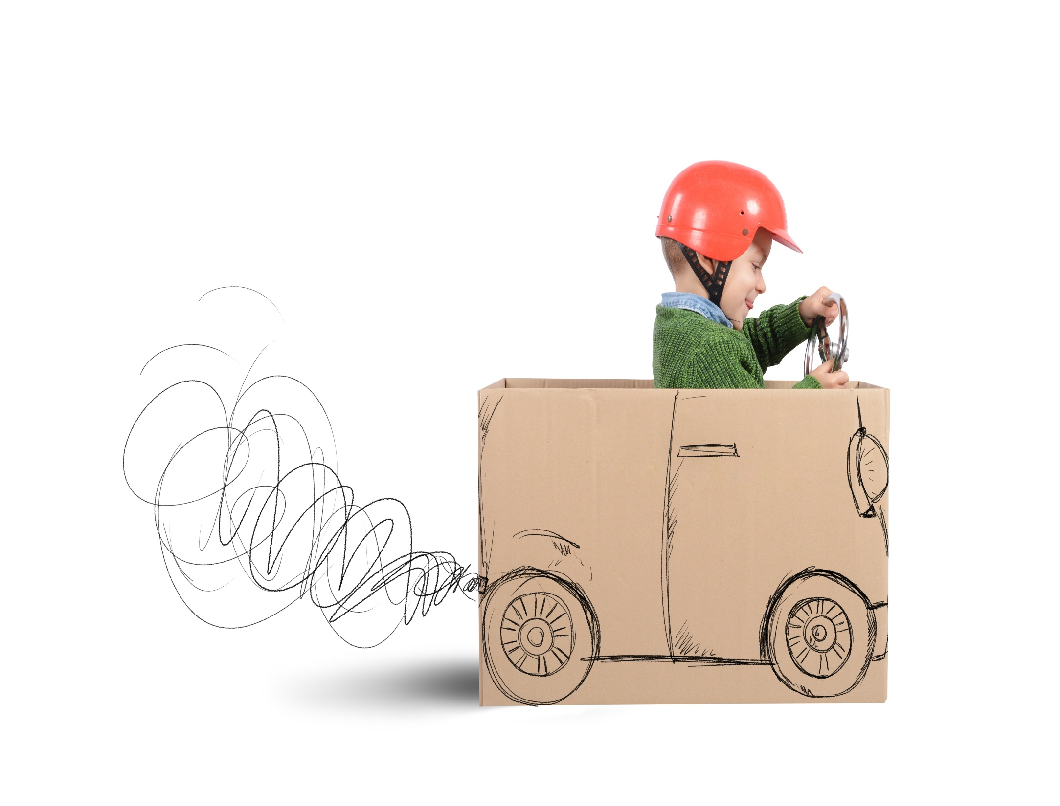
Andreas loves cars. He ______
a toy car for his birthday next week.
gets
is going to get
got

Slide 10
Dina _____ dancing lessons
every Saturday.
is having
has
is going to have

Slide 11
Presentation designed by the English Curriculum Development team, Cyprus Ministry of Education and Culture

