Slide 1
Unit 2 Year 6
Lesson 5 - Review

Slide 2
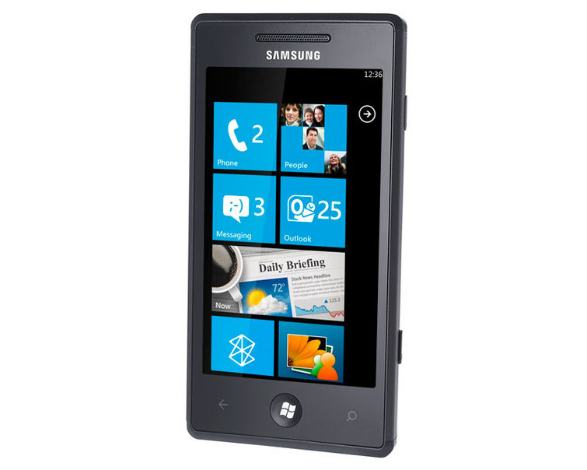
This is something that we use to talk to each other.
What is it?
A telephone.

Slide 3
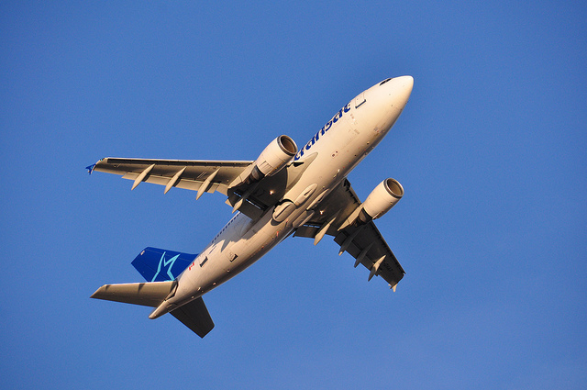
This is something that flies. We use it to travel from place to place.
What is it?
An airplane.

Slide 4
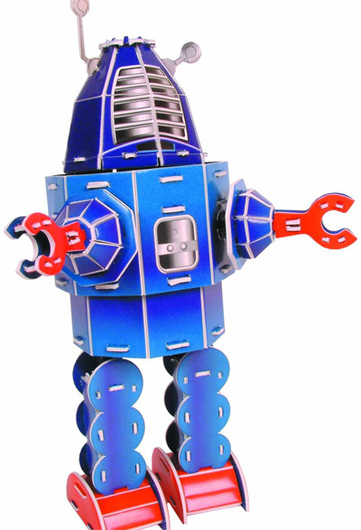
This is something that moves its body and head. It does whatever we tell it to do.
What is it?
A robot.

Slide 5
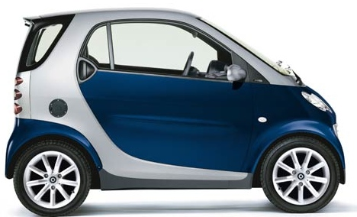
This is something that can takes you from place to place. It’s got 4 wheels.
What is it?
A car.

Slide 6
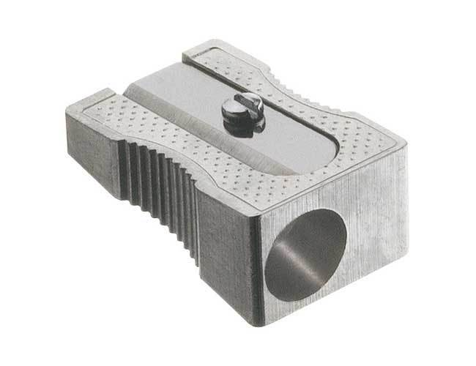
This is something that can sharpen our pencils.
What is it?
A pencil sharpener.

Slide 7
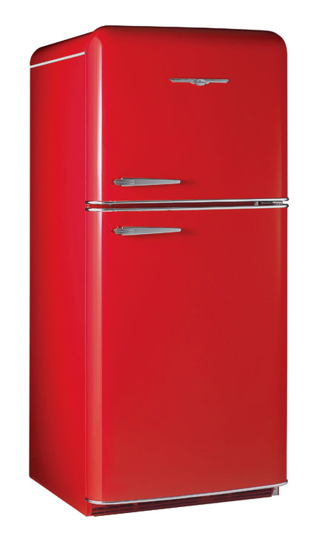
This is something that we use to keep our food and drinks cold.
What is it?
A fridge.

Slide 8
Images courtesy of Microsoft clipart
Presentation designed by the English Curriculum Development team, Cyprus Ministry of Education and Culture

